Slide 1
Similar Triangles
Panašūs trikampiai

Slide 2
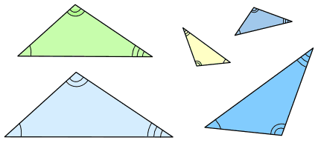
Similar Triangles
Triangles are similar if they have the same shape, but not necessarily the same size
These triangles are all similar:
http://www.mathsisfun.com/geometry/triangles-similar.html

Slide 3
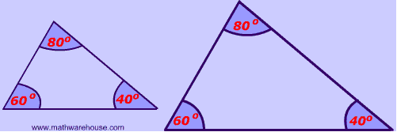
What is true about the angles of similar triangles?
Answer:
They are congruent (sutampantys)

Slide 4
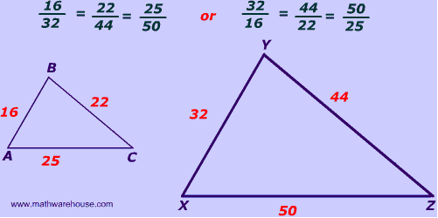
What is true about the sides of similar triangles?
Answer:
The corresponding sides are proportional.

Slide 5
What is the similarity ratio?
Answer:
It's the ratio between the corresponding sides.

Slide 6
How to Find if Triangles are Similar?
Two triangles are similar if they have:
all their angles equal;
corresponding sides are in the same ratio.

Slide 7
There are three ways to find if two triangles are similar: AA, SAS and SSS

